Slide 1
Cornerstone Bible Institute Session 5 May 23, 2009
The Incommunicable Attributes of God

Slide 2
An attribute is simply something that is true about God.
A.H. Strong - "The attributes of God are those distinguishing characteristics of the divine nature which are inseparable from the idea of God and which constitute the basis and ground for his various manifestations to his creatures.”
Millard Erickson - "When we speak of the attributes of God, we are referring to those qualities of God which constitute what he is. They are the very characteristics of his nature. We are not referring here to the acts which he performs. . . "

Slide 3
There is a distinction being made between the attributes of God and the acts of God.

Slide 4
Communicable & Incommunicable
A "Communicable" attribute is a character quality of God that is more reflected by man.
An "Incommunicable" attribute is a character quality of God that is less reflected by man.

Slide 5
Incommunicable Attributes |  | Communicable Attributes
Incomprehensibility |  | Holiness
Self-Existence (Aseity) |  | Righteousness (Justice)
Immutability |  | Wrath
Eternity |  | Truthfulness
Sovereignty |  | Goodness
Freedom |  | Mercy
Spirituality |  | Grace
Invisibility |  | Love
Omnipresence |  | Jealousy
Perfection |  | Knowledge
Blessedness |  | Wisdom
Beauty |  | Patience
Glory |  | Peace (Order)

Slide 6
When we study the attributes of God, we are seeking not merely to know character qualities but we are seeking to know a person.
John 17:3 - And this is eternal life, that they may know Thee, the only true God, and Jesus Christ whom Thou hast sent.
1 John 2:13 - I have written to you, children, because you know the Father.
Jeremiah 9:23-24 - Thus says the LORD, "Let not a wise man boast of his wisdom, and let not the mighty man boast of his might, let not a rich man boast of his riches; but let him who boast boast of this, that he understands and knows Me, that I am the LORD who exercises lovingkindness, justice, and righteousness on the earth; for I delight in these things."

Slide 7
Misconceptions regarding the Attributes of God
We should not think of God as some kind of collection of various attributes added together.
We should not think of the attributes of God as something external from God's real being or real self.
Instead, we should understand each attribute of God as being true of all of God's being, and every attribute qualifying every other attribute.

Slide 8
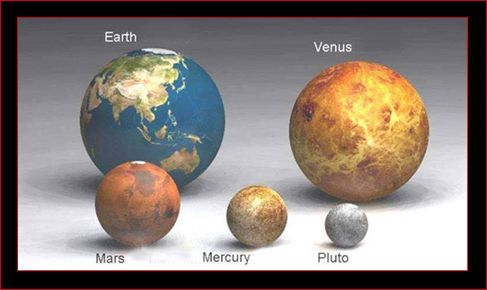

Slide 9
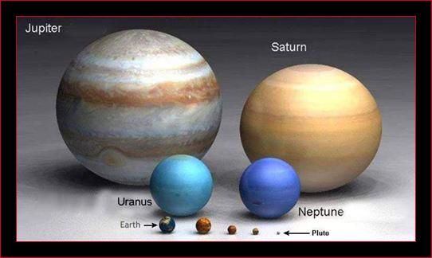

Slide 10
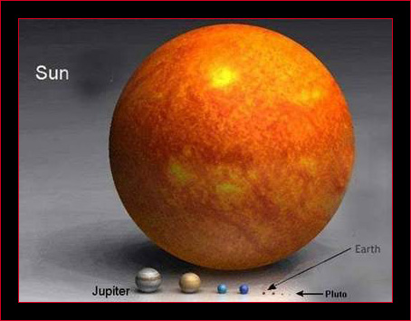

Slide 11
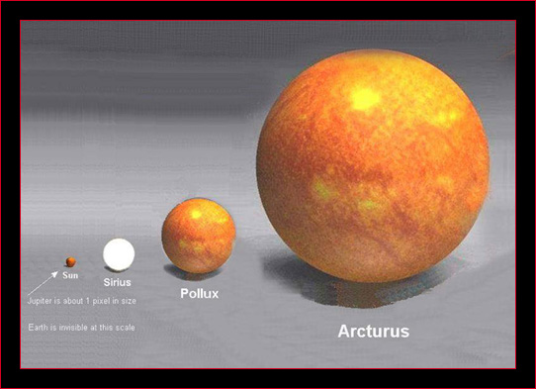

Slide 12
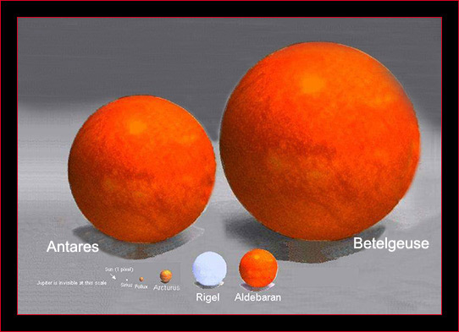

Slide 13
Video: Planets and Stars

Slide 14
Psalm 147:4-5 – He counts the number of the stars; He gives names to all of them. Great is our Lord, and abundant in strength; His understanding is infinite.
Psalm 148:1-6 – Praise the LORD! Praise the LORD from the heavens; Praise Him in the heights! Praise Him, all His angels; Praise Him, all His hosts! Praise Him, sun and moon; Praise Him, all stars of light! Praise Him, highest heavens, And the waters that are above the heavens! Let them praise the name of the LORD, For He commanded and they were created. He has also established them forever and ever; He has made a decree which will not pass away.
Psalm 148:1-5 – Praise the LORD! Praise the LORD from the heavens; Praise Him in the heights! Praise Him, all His angels; Praise Him, all His hosts! Praise Him, sun and moon; Praise Him, all stars of light! Praise Him, highest heavens, And the waters that are above the heavens! Let them praise the name of the LORD, for He commanded and they were created.

Slide 15
Psalm 33:6-8 – By the word of the LORD the heavens were made, And by the breath of His mouth all their host. He gathers the waters of the sea together as a heap; He lays up the deeps in storehouses. Let all the earth fear the LORD; Let all the inhabitants of the world stand in awe of Him.
Isaiah 40:25-26 – “To whom then will you liken Me That I should be his equal?” says the Holy One. Lift up your eyes on high And see who has created these stars, The One who leads forth their host by number, He calls them all by name; Because of the greatness of His might and the strength of His power Not one of them is missing.
Job 26:7,9,14 – He stretches out the north over empty space, And hangs the earth on nothing. . . He obscures the face of the full moon, And spreads His cloud over it. . . Behold, these are the fringes of His ways.;

Slide 16
Psalm 8:3 - When I consider Thy heavens, the work of Thy fingers, the moon and the stars, which Thou hast ordained; What is man, that Thou dost take thought of him? And the son of man, that Thou dost care for him?
Psalm 33:13, 18 – The LORD looks from heaven; He sees all the sons of men; From His dwelling place He looks out On all the inhabitants of the earth, He who fashions the hearts of them all, He who understands all their works. . . Behold, the eye of the LORD is on those who fear Him, On those who hope for His lovingkindness, To deliver their soul from death, And to keep them alive in famine. Our soul waits for the LORD; He is our help and our shield. For our heart rejoices in Him, Because we trust in His holy name. Let Thy lovingkindness, O LORD, be upon us, According as we have hoped in Thee

Slide 17
Cornerstone Bible Institute Session 5 May 23, 2009
Introduction to the
Incommunicable Attributes of God

Slide 18
The incommunicable attributes of God impress upon us the truth that there is no one like God!
Exodus 15:11 – “Who is like Thee among the gods, O LORD? Who is like Thee, majestic in holiness, Awesome in praises, working wonders?
Isaiah 55:8-9 – “For My thoughts are not your thoughts, Neither are your ways My ways,” declares the LORD. For as the heavens are higher than the earth, So are My ways higher than your ways, And My thoughts than your thoughts.
Romans 11:36 – For from Him and through Him and to Him are all things

Slide 19
The Incomprehensibility of God
Because God is infinite and we are finite, we can never fully understand God
Psalm 145:3 – Great is the LORD, and highly to be praised; And His greatness is unsearchable.
Psalm 139:6 – Such knowledge is too wonderful to me; It is too high; I cannot attain to it.
Psalm 139:17-18 – How precious also are Thy thoughts to me, O God! How vast the sum of them! If I should count them, they would outnumber the sand.
Romans 11:33-36 – Oh, the depth of the riches both of the wisdom and the knowledge of God! How unsearchable are His judgments and unfathomable His ways! For who has known the mind of the LORD, or who became His counselor? Or who has first given to Him that it might be paid back to Him again? For from Him and through Him and to Him are all things. To Him be the glory forever. Amen.

Slide 20
Although we can not know God fully, we can know God accurately.
Within each single attribute there is an incomprehensible depth of understanding to be explored.
Theology is both humbling and joy-producing.
Heaven will be an eternity of unfolding progression of revelation.

Slide 21
The Self-Existence of God
God depends on nothing else for existence. He has eternally existed without any external or prior cause.
Exodus 3:14 - And God said to Moses, "I AM WHO I AM"; and He said, "Thus you shall say to the sons of Israel, 'I AM has sent me to you.‘”
John 8:58 when He said, “Truly, truly, I say to you, before Abraham was born, I am.”
Revelation 4:8 – “Holy, holy, holy, is the LORD God, the Almighty, who was and who is and who is to come.”
Acts 17:24-25 – The God who made the world and all things in it, since He is Lord of heaven and earth, does not dwell in temples made with hands; neither is He served by human hands, as though He needed anything, since He Himself gives to all life and breath and all things.

Slide 22
Augustine - God is the absolute IS.
J.I. Packer – “Our Maker exists in an eternal, self-sustaining, necessary way. . . necessary, that is, in the sense that God does not have it in Him to go out of existence, just as we do not have it in us to live forever. We necessarily age and die, because it is our present nature to do that; God necessarily continues forever unchanged, because it is His eternal nature to do that.”

Slide 23
Grudem: “God’s being is. . . something totally unique. It is not just that God does not need the creation for anything; God could not need the creation for anything. The difference between the creature and the Creator is an immensely vast difference, for God exists in a fundamentally different order of being. It is not just that we exist and God has always existed; it is also that God necessarily exists in an infinitely better, stronger, more excellent way. The difference between God’s being and ours is more than the difference between the sun and a candle, more than the difference between the ocean and a raindrop, more than the difference between the arctic ice cap and a snow flake, more than the difference between the universe and the room we are sitting in: God’s being is qualitatively different. No limitation or imperfection in creation should be projected onto our thought of God. He is the Creator; all else is creaturely. All else can pass away in an instant; he necessarily exists forever.”

Slide 24
The difference between the Creator and the creation is not a matter of degrees.
God is not merely self-caused, He is the uncaused.
The wonder of the gospel is that the independent God became dependent.

Slide 25
The Immutability of God
God is unchangeable in His essence, attributes, consciousness and will.
Psalm 102:25-27 – “Of old Thou didst found the earth; And the heavens are the work of Thy hands. “Even they will perish, but Thou dost endure; And all of them will wear out like a garment; Like clothing Thou wilt change them, and they will be changed. “But Thou art the same, And Thy years will not come to an end.”
Malachi 3:6 – “For I, the LORD, do not change; therefore you, O sons of Jacob, are not consumed.
James 1:17 – Every good thing bestowed and every perfect gift is from above, coming down from the Father of lights, with whom there is no variation, or shifting shadow.
Hebrews 13:8 – Jesus Christ is the same yesterday and today, yes and forever.

Slide 26
Deuteronomy 32:4 - "The Rock! His work is perfect, For all His ways are just; A God of faithfulness and without injustice, RIghteous and upright is He.“
Herman Bavinck - “The doctrine of God’s immutability is of the highest significance for religion. The contrast between being and becoming marks the difference between the Creator and the creature. Every creature is continually becoming. . .. only he is pure being and no becoming. Hence, in Scripture God is often called the Rock. . . “

Slide 27
God's immutability is of great comfort to the believer in Christ.
A.W. Pink - “Herein is solid comfort. Human nature cannot be relied upon; but God can! However unstable I may be, however fickle my friends may prove, God changes not. If He varied as we do, if He willed one thing today and another tomorrow, if He were controlled by caprice, who could confide in Him? But, all praise to His glorious name, He is ever the same. His purpose is fixed, His will stable, His word is sure. Here then is a rock on which we may fix our feet, while the mighty torrent is sweeping away everything around us. The permanence of God’s character guarantees the fulfillment of His promises. . . “

Slide 28
God's immutability is closely tied into His self-existence.
God's immutability is the fundamental difference between Him and the creation.
Because God is immutable His promises and His plans are sure and unchanging.

Slide 29
The Eternity of God
God is infinite in relation to time.
Genesis 21:33 – And Abraham planted a tamarisk tree at Beersheba, and there he called on the name of the LORD, the Everlasting God.
Isaiah 40:28 – Do you not know? Have you not heard? The Everlasting God, the LORD, the Creator of the ends of the earth Does not become weary or tired. His understanding is inscrutable.
Psalm 90:2 – Before the mountains were born, Or Thou didst give birth to the earth and the world, Even from everlasting to everlasting, Thou art God.
Revelation 1:8 – “I am the Alpha and the Omega,” says the Lord God, “who is and who was and who is to come, the Almighty.”

Slide 30
Wayne Grudem - "God has no beginning, end, or succession of moments in his own being, and he sees all time equally vividly, yet God sees events in time and acts in time."
God's eternity is closely related to His immutability.
God is not changed by the succession of moments in time.
The wonder of the gospel is that God who was infinite in relation to time, stepped into history!
Galatians 4:4 - But when the fullness of the time came, God sent forth His Son, born of a woman, born under the Law, in order that He might redeem those who were under the Law, that we might receive the adoption as sons.”

Slide 31
Questions for Application and Discussion
Why is having a high view of God the foundation for experiencing joy as a Christian? Which one of the attributes we have discussed (incomprehensibility, self-existence, immutability, eternity) has helped you the most enlarge you understanding of God?
Do you have an emotional response to any of these attributes? Are any of them convicting? Encouraging? Inspiring? Challenging? Please share your response.
How would you use the doctrine of God’s immutability to encourage a believer who is doubting God’s love? Who feels that God doesn’t hear his prayer? Who doesn’t feel that God can forgive his sin? Explain.

Slide 32
The Love of God and the Faithfulness of God
A Story of Undying Love

Slide 33
Next CBI Session: June 6, 2009: 8-11am
Last session of this class!

